Slide 1

Erectile Dysfunction Treatment Options

Slide 2
Disclaimer
This information is intended to be an educational resource for general information purposes only. It is not medical advice or a replacement for the independent medical judgment of a trained and licensed physician or other medical professional.
For any medical devices depicted in this session, please see complete product instructions for use, including all product indications, contraindications, precautions, warnings, and potential complications. The medical advice and recommendations expressed by the presenter are those of the presenter.
This material is intended for medical professionals for general information purposes only. This information is provided as a general guide, only, as of January 2024. If this is being viewed as a recorded video, neither the presenter nor the corporate sponsor agree that you may download or record this video content in any manner for storage and later retrieval and replay.
There was corporate sponsorship of this educational presentation.

Slide 3
The goal of this presentation is to educate men and their partners about erectile dysfunction and treatment options.
01.
Erectile Dysfunction (ED) Facts
What is ED
Causes of ED
Psychological effects of ED
02.
Hope for ED: Treatment options
03.
Patient perspective
04.
Additional resources

Slide 4

ED can be hard
ED not only impacts your intimate moments with your partner but also impacts your daily life and overall confidence.¹
Thank you for taking the first step to finding a solution to help you take back control of your intimate moments.¹

Slide 5




You’re not alone - ED is common
ED affects up to
in the United States²
ED affects
by the age of 40²
While ED is common,
50 million
40% of
in most cases, it can be treated.^{3,4}
men
men

Slide 6

ED also has many psychological effects¹
A survey completed by men with ED showed that ED not only has physical impacts, but also has psychological effects
50% of patients say ED negatively impacts their everyday life
84% of patients say that ED
causes them to have
lower confidence
Negative impact on emotions felt when thinking about the inability to achieve/maintain/sustain
an erection:
Disappointed
Frustrated/Angry
Ashamed/Embarrassed
Inferior/Insecure
50% of patients say ED negatively impacts their relationship with their significant other
69% of patients say that ED negatively impacts their ability to have intimacy

Slide 7
ED Facts: What is ED?³
ED is the consistent inability to sustain an erection sufficient for sexual intercourse
ED can be:
  Not getting an erection at all
  Getting an erection inconsistently
  Getting an erection that doesn’t stay hard enough for sex

Slide 8


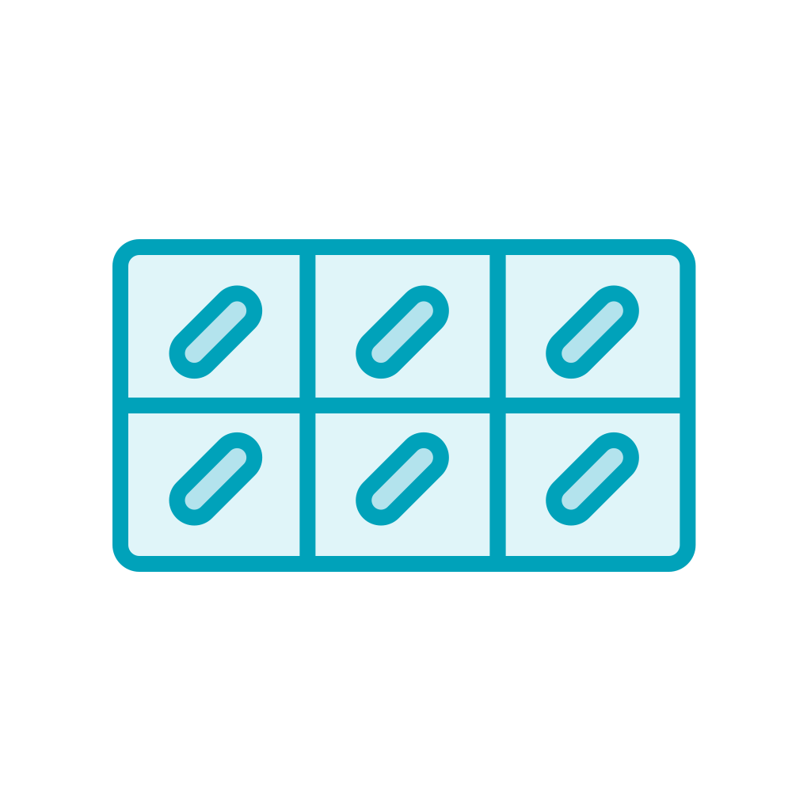


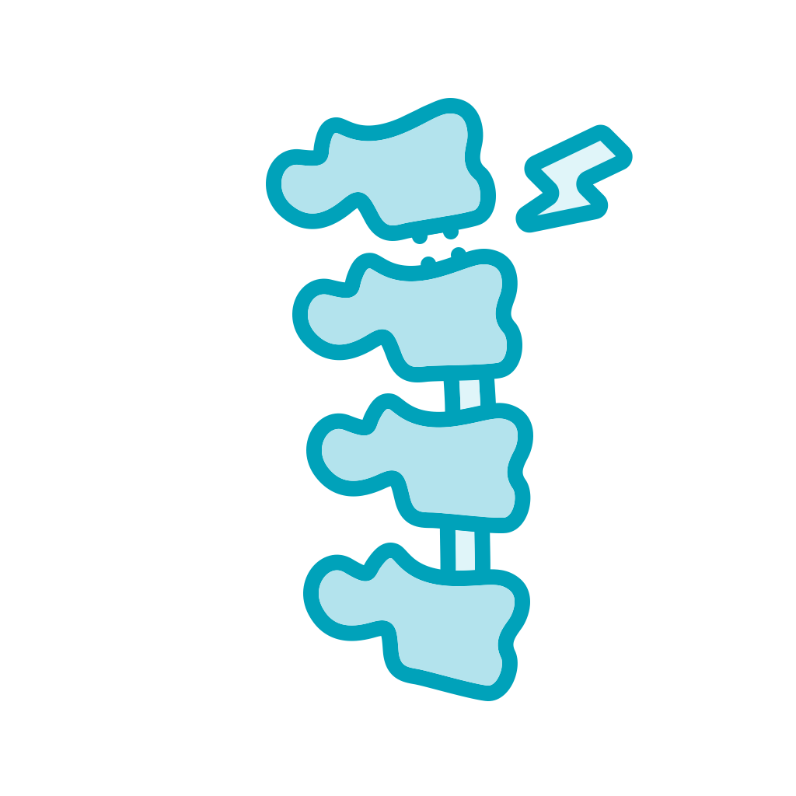
ED Facts: What causes ED?
While erectile dysfunction is common, it is not
an inevitable part of aging³
80%
Physical causes include:⁵
Disease: such as diabetes, high blood pressure or
cardiovascular disease
Surgery: such as
prostate removal
Medication/substance use: such as tobacco,
drugs, alcohol and
some medications
Injury: such as pelvis or
spinal cord injury
of the time ED
is caused by a physical problem or disorder⁶

Slide 9
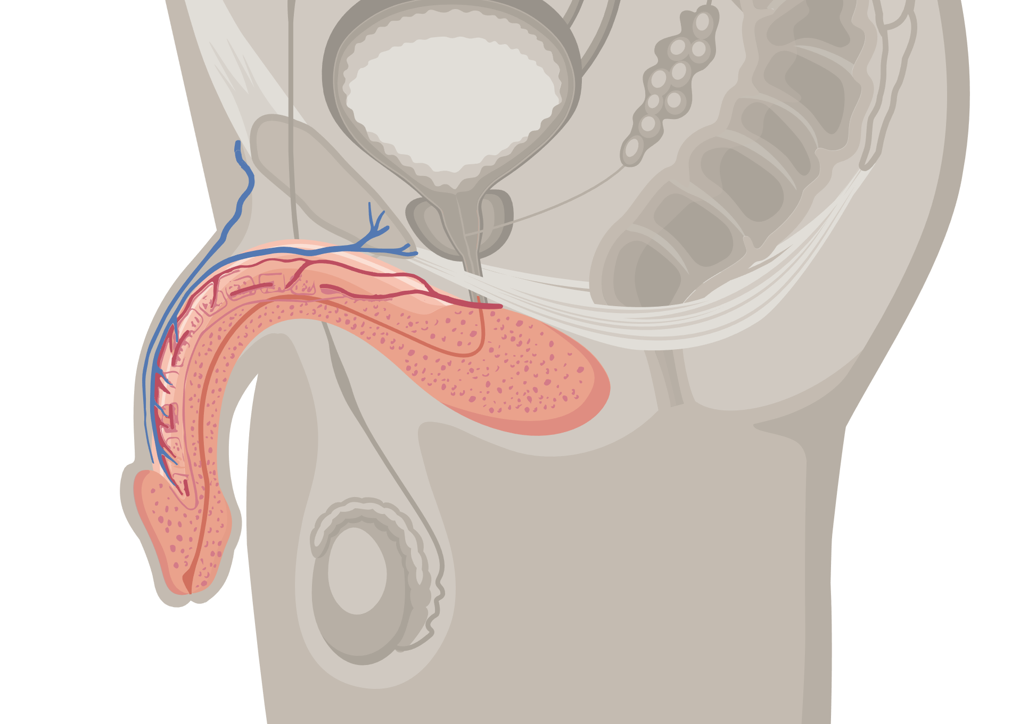
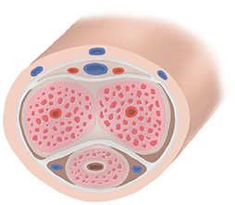
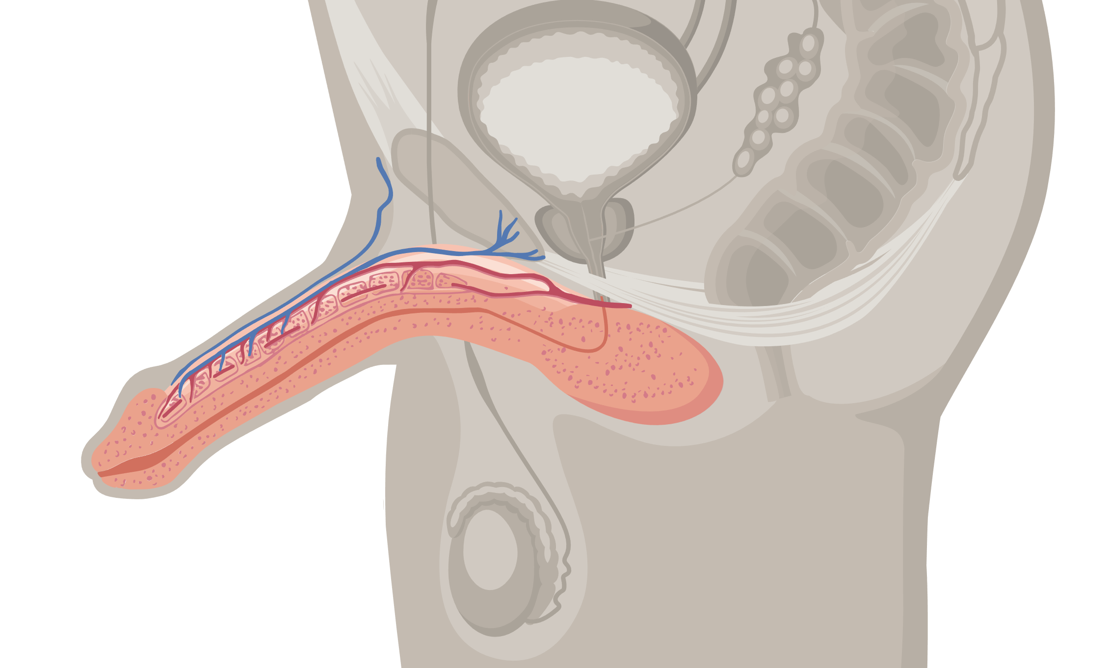

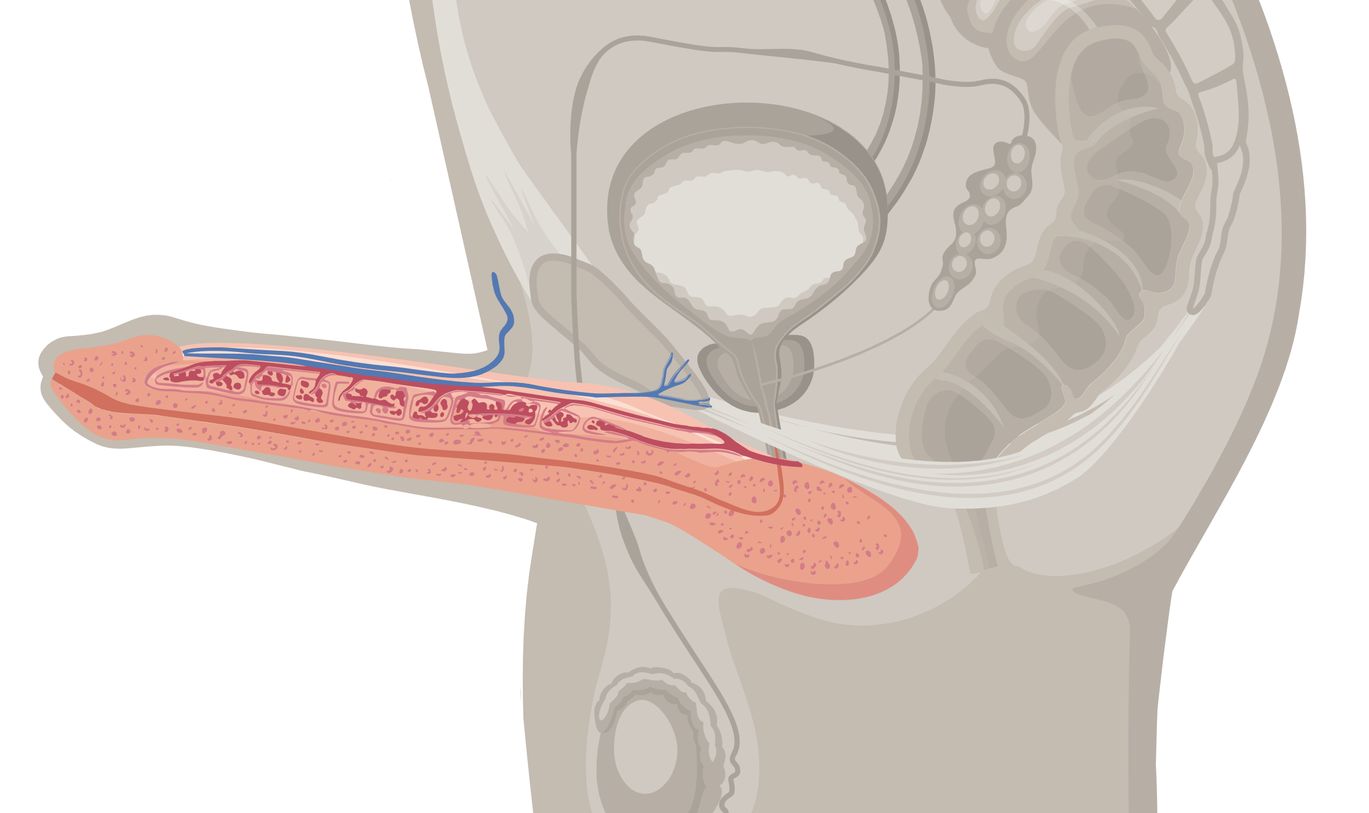
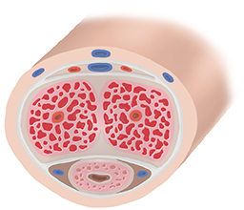
How does an erection occur?⁷
1
Sexual stimulation and excitement cause the brain, nerves, the heart, blood vessels and hormones to work together to produce a rapid increase in the amount of blood flowing to the penis
2
The blood becomes trapped and held in the two spongy chambers in the shaft of the penis
3
As the chambers rapidly fill with blood, they expand, and the penis becomes firm and elongated. The result is an erection.

Slide 10
No matter what the cause of your ED, there is hope. There are solutions available.⁴

Slide 11
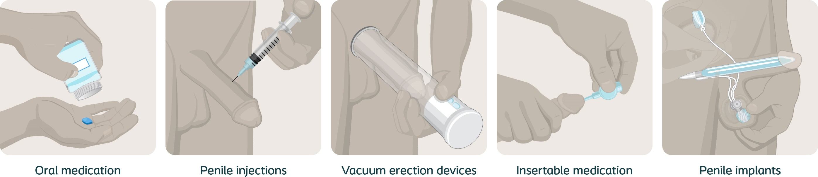
Hope for ED: Treatment options⁴

Slide 12
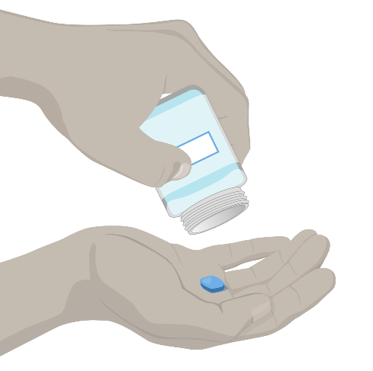
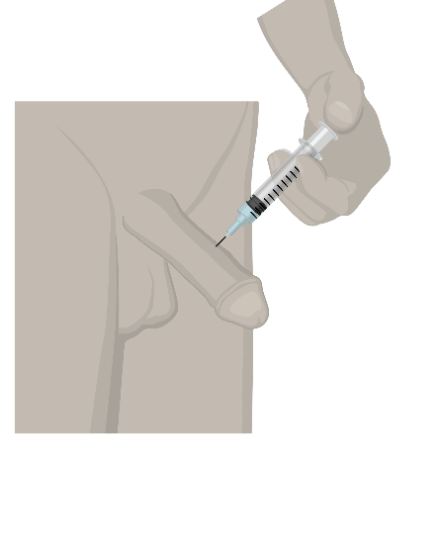
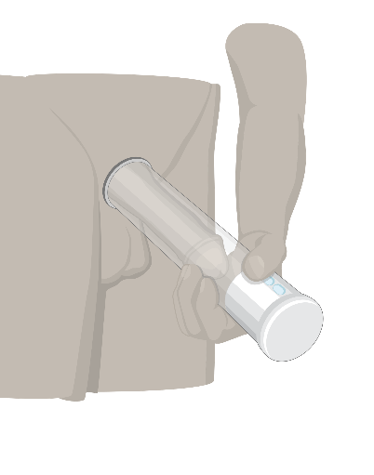
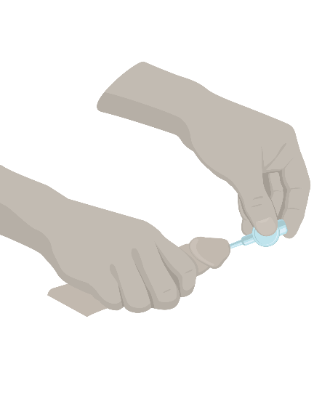
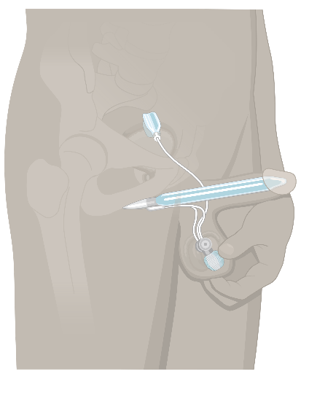
Hope for ED: Treatment options
Most men start with oral medications as an ED therapy⁸
While these work great for many men, it is estimated that for 40% of cases,
they are not effective⁹
50% of patients discontinue treatment in the first year due to reasons such as:¹⁰
Medication failure
Cost
Concerns about side effects or long-term safety
Oral
medications

Slide 13


Hope for ED: Treatment options*
Oral medications
Potential side effects¹¹
Drug therapy includes prescription
medication (PDE5 inhibitor)
These pills may help achieve erections in
response to sexual stimulation:
  Do not provide automatic erections
  like penile injections
  Must take at least ½ hour to one hour before
  anticipated sexual activity¹¹
  Headaches
  Facial blushing
  Upset stomach
  Back pain/muscle aches
  Nasal congestion
Oral medications are
not effective in approximately 40% of cases⁹

Slide 14


Hope for ED: Treatment options
Penile
injections
When oral medications fail, some men move on to try injections
Injections work great for many men,
but fail to work or cause priapism (erection lasting 4 hours or more) approximately 30% of the time⁹

Slide 15

Hope for ED: Treatment options
Penile injections
Advantages
Potential side effects¹³
Onset of
erection within
5-20 minutes¹²
  Risk of erection lasting 4 hours or more (priapism)
  Penile pain
  Penile numbness, irritation, sensitivity, itching, swelling and discoloration
  Bruising at the injection site
  Penile fibrosis (deformed penis shape)
  Penile rash
  Requires training¹²

Slide 16
Hope for ED: Treatment options
Vacuum erection devices
A vacuum erection device is another treatment available for ED
The device can be used individually or in combination with other ED treatments¹⁴

Slide 17
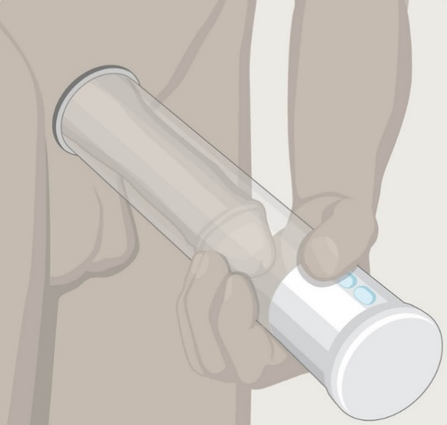
Hope for ED: Treatment options
Vacuum erection devices
Advantages¹⁴
Potential side effects¹⁴
Therapeutic benefits
Drug-free, no medications or injections
Cost effective
  Erection is not warm to the touch
  Penile discomfort
  Penile numbness
  Bruising
  Swelling
  Inability to ejaculate
  Painful ejaculation

Slide 18

Hope for ED: Treatment options
Insertable
medication
Compared to other ED pharmaceutical treatment options, insertable drugs are not as commonly prescribed.⁸

Slide 19

Hope for ED: Treatment options
Insertable medication
Advantages¹⁵
Potential side effects¹⁵
Urethral suppository
    An applicator containing a small pellet (suppository) is inserted in the urethra and the pellet is released
    Pellet dissolves and increases blood flow creating an erection
Why choose a transurethral system
Erections usually start within
10 minutes
Erections last between
30 and 60 minutes
Side effects can include burning and aching in the penis and groin
With this therapy, it does not require giving a shot in the penis, however, it may not work as well as penile injections⁷

Slide 20


Hope for ED: Treatment options
For some patients, when pills and injections no longer work, they move to a penile implant
Other patients may move to a penile implant
right away⁴
Penile
implants

Slide 21
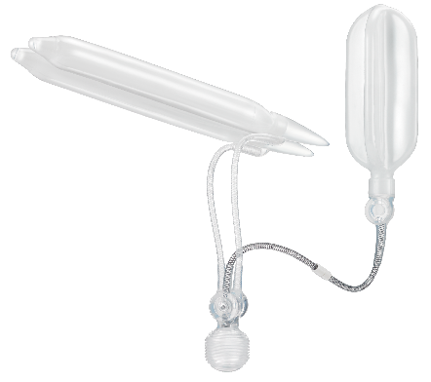





Hope for ED: Treatment options
Penile implants
Advantages
Long-term ED solution
Penile implants are a long-term ED solution with over 75% lasting 10 years or more.¹⁶
A discrete treatment for ED
A penile implant is concealed inside the body and is not visibly noticeable. The penis appears relaxed and normal when in the flaccid state.¹
Spontaneity
Designed to mimic the look and performance of a natural erection, penile implants give men the ability to have an erection instantly and spontaneously, any time.¹
Control
Penile implants are easy to use and activate, removing the hassle of pills and needles. They put the man back in control of his body without any clunky equipment or medications.¹

Slide 22

Penile implant satisfaction rates
98%
Patient satisfaction with a
penile implant for erectile dysfunction¹
96%
Partner satisfaction with a
penile implant for erectile dysfunction¹⁷

Slide 23
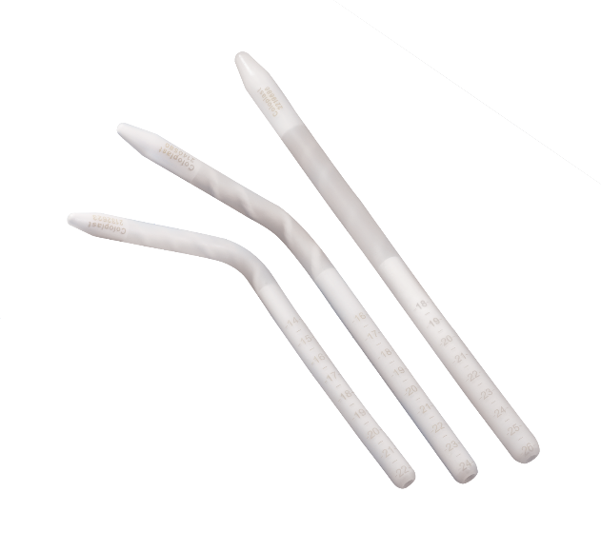
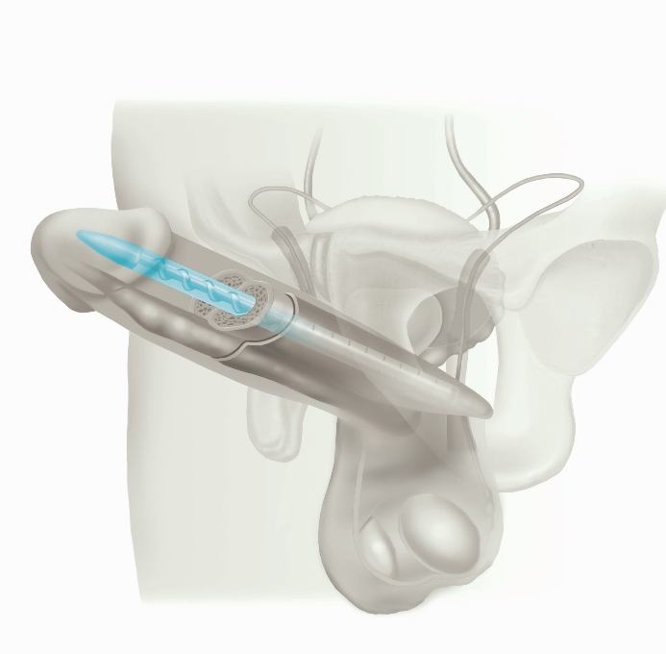
Hope for ED: Treatment options
Penile implants
Advantages
Easy for you or your partner to use¹⁸
Good option for men with limited dexterity¹⁸
Concealed inside the body¹⁹
Less expensive than inflatable penile implant¹⁸
Disadvantages¹⁹
Remains firm when not in erect position

Slide 24

Risks of penile implants
Implantation of both inflatable and malleable penile implants requires surgery. The device is implanted during a procedure through a small opening in the skin. Most men return home from the procedure on the same day and are able to resume sexual activity upon doctor’s clearance, typically between four and six weeks.²⁰
  Like every surgical treatment, there are potential risks with penile implants. The most common risks of penile implants include, but are not limited to:²¹
  Device malfunction (e.g., break, rupture, leakage, tear)
  Infection
  Inflation difficulty
  Erosion
  Incorrect sizing
  Make latent natural erections, as well as other
  treatment options impossible
  Please see the Important Safety Information at the end of this presentation for additional risk information.
Penile implants require surgery. Risks of surgery may include but are not limited to complications such as infection, scrotal swelling, pain and discomfort. Once implanted, the system may present the opportunity for infection or device malfunction which may require additional surgery.

Slide 25
Insurance coverage for penile implants
Penile implants are covered under most insurance plans, including Medicare²²
A penile implant is prescribed
by a physician
Insurance specialists in the physician’s office
can help confirm your coverage
Contact your insurance company to understand
what, if any, out-of-pocket expenses might be
What if I get denied?
Right to appeal any denial
from health plan
Detailed out-of-pocket
costs can be obtained from your urologist
Explore alternative insurance and financing options

Slide 26

Frequently asked questions
How much does the implant procedure cost? Is it covered by insurance?
Will this affect size of my penis?
Are orgasms and ejaculation impacted by the implant?
Will a penile implant impact the sensation in my penis?
Will anyone notice that I have the implant?
Will my partner notice a difference during intercourse? How natural is it?
How long does the penile implant last?
What is the recovery period like? Is it painful? When can I use the device?
Can I continue my normal workout routine and everyday activities?
Will I be able to have spontaneous erections with a penile implant?
Do penile implants interfere with other equipment (i.e. MRI, airport security machines)?

Slide 27
Visiting a specialized urologist
Not all urologists specialize in ED and perform the penile implant procedure.
It is important to research any potential urologist to find one that is experienced and trusted!

Slide 28
Titan® and Titan Touch Inflatable Penile Prosthesis: Important Safety Information
The Titan Inflatable Penile Prosthesis is a surgically implanted mechanical penile implant intended for the treatment of erectile dysfunction in men. The Titan implant is a 3-piece fluid-filled system manually operated to produce and sustain an erection for sexual intercourse.
Indications
The Titan Inflatable Penile Prosthesis is indicated for male patients with erectile dysfunction who are considered to be candidates for implantation of a penile prosthesis.
Contraindications
The Titan implant is not for use in patients who have one or more of the following conditions: 1) have an active infection, particularly urinary tract or genital infection, 2) are sensitive or allergic to silicone or polyurethane, 3) have ongoing difficulty urinating or emptying the bladder (e.g., bladder outlet obstruction or neurogenic bladder), or 4) unwilling to undergo any further surgery for device revision.
Warnings
Patients should consider the warnings, precautions and potential complications associated with the use of this product, which may include the following: potential for resurgery (note: device is not a lifetime implant). Implantation makes latent natural erections, as well as other interventional treatment options, impossible. Implantation may result in penile shortening, curvature or scarring. Pre-existing abdominal or penile scarring or contracture may make surgical implantation more complicated or impractical. Diabetic, as well as immunocompromised patients, may have an increased risk of infection which could result in permanent damage to tissue/organs. Excessive stresses from rigorous exercise and vigorous masturbation/intercourse could lead to device damage. Certain stresses and pressures (straddle seating, obesity, etc.) could lead to involuntary inflation or deflation. Post-implant penile size, girth and angle can vary based on patient anatomy, implant size, level of inflation, and presence of Peyronie’s disease.
Precautions
Patients with spinal cord injury may have an increased risk of infection. This device may be used to treat erectile dysfunction in the presence of Peyronie’s disease. Although the implant is not visible, depending on the placement (submuscular) the reservoir may be palpable.

Slide 29
Titan® and Titan® Touch Inflatable Penile Prosthesis: Important Safety Information
Patients should consider the following factors which could lead to increased risk of failure and can be critical to the eventual success of the procedure: ability and willingness of the patient to follow instructions; associated psychological status (e.g., psychogenic erectile dysfunction, inappropriate attitude or motivation); health conditions which hamper sexual activity (such as severe angina) may prevent successful use of this device; manual dexterity problems; and lack sufficient manual dexterity or strength necessary to operate the device.
Impact injuries to the pelvic or abdominal areas (e.g., sports injuries) can result in damage to the implant which may necessitate replacement of the device. Contracture of tissue around the pump can cause unnatural firmness in the scrotum and involuntary inflation or deflation. The device may fail to deflate and/or deflation of the device may be slow or difficult for some patients. Device malfunctions may result in the inability to inflate or deflate the device. Removal of the device without timely reimplantation of a new implant may complicate subsequent reimplantation.
Potential Complications
Adverse events are known to occur with penile protheses procedures and implants; some may require revision surgery or removal of the implant. Adverse events following penile protheses implantation may be new onset (de novo), persistent, worsening, transient, or permanent.
Adverse events may include but are not limited to: inability to pull foreskin back from tip of uncircumcised penis (acquired phimosis); abnormal wound healing/adhesion/scar tissue; bladder storage symptoms/urinary retention; tightening, shortening, deformity or curvature of penis (capsular contracture, induration); discomfort/pain; injury to tissue or organs (perforation/erosion/extrusion) resulting in damage or loss of tissue (necrosis); open tunnel between tissue or organs (fistula); foreign body reaction/allergic reaction/sensitivity; bleeding/hemorrhage or collection of blood or fluid outside of tissue or vessels (hematoma/seroma); hernia; Infection/urinary tract infection; redness or swelling (inflammation/edema); difficult or painful intercourse (dyspareunia/sexual dysfunction); obstruction/occlusion; numbness or decreased sensation (e.g., hypoesthesia); and urinary incontinence. The occurrence of these events may require one or more subsequent surgeries which may or may not always fully correct the complication.
This treatment is prescribed by your physician. Discuss the treatment options with your physician to understand the risks and benefits of the various options to determine if an inflatable penile implant is right for you.
Caution: Federal law (USA) restricts this device to sale by or on the order of a physician.
PM-15451 / Feb 2024

Slide 30
Genesis® Malleable Penile Prosthesis – Important Safety Information
A penile implant, also called a penile prosthesis, is concealed entirely within the body to address erectile dysfunction (impotence). The device is manually positioned to simulate an erect or flaccid penis.
Intended Purpose
The Genesis Malleable Penile Prosthesis is a flexible silicone elastomer device designed to be implanted into the penis for the management of erectile dysfunction (commonly known as impotence).
Indications
The prosthesis is designed for the management of erectile dysfunction (impotence) stemming from a variety of causes, including: epispadias (a rare birth defect located at the opening of the urethra), pelvic fracture; spinal cord injury or disease; prostatectomy; cystectomy; abdominal-perineal resection (surgical removal of the anus, rectum, and sigmoid colon); multiple sclerosis; diabetes mellitus; alcoholism; arteriosclerosis and hypertensive vascular disease; priapism (prolonged and painful erection of the penis); and Peyronie’s disease (curvature of the penis). The Prosthesis may also be used in selected patients with psychogenic impotence.
Contraindications
The Genesis Malleable Penile Prosthesis should not be used in: patients with an active infection present anywhere in the body, especially urinary tract or genital infection; patients with a documented sensitivity to silicone; and, patients with unresolved urinary problems, such as an elevated residual urine volume secondary to bladder outlet obstruction or neurogenic bladder.
Warnings
Implantation of a penile Prosthesis may make natural erections difficult to achieve. It may make some other interventional treatment options not possible. Implantation of a penile Prosthesis may result in penile shortening, curvature or scarring. Men with diabetes as well as immunocompromised patients, may have an increased risk of infection which could result in permanent damage to tissue/organs.
Consult with your physician if you are experiencing a change in rigidity or appearance of the erect penis. Replacement of the prosthesis may be necessary. If you have borderline bladder decompensation, an indwelling catheter, or enlargement of the prostate talk to your doctor.

Slide 31
Genesis® Malleable Penile Prosthesis – Important Safety Information
Precautions
Patients should be informed that erections achieved with a malleable penile Prosthesis may differ from original erection (e.g. not of equal length or girth) compared to what was previously experienced with natural erections. Talk with your physician regarding realistic expectations. Health conditions which hamper sexual activity (e.g. severe angina) may prevent successful use of this device. Penile implants are not considered lifetime implants due to the inherent nature of mechanical devices. Trauma to the pelvic area, such as impact injuries associated with sports, can result in damage of the implanted device and/or surrounding tissues. This damage may result in the malfunction of the device and may necessitate surgical correction, including replacement of the device.
Potential Complications
Adverse events are known to occur with penile protheses procedures and implants; some may require revision surgery or removal of the implant. Adverse events following penile protheses implantation may be new (de novo), persistent, worsening, lasting for a short time (transient), or permanent.
Penile implants are surgical solutions requiring a healing period that have risks associated with surgery such as deformity, delayed / impaired / abnormal wound healing, injury to tissue or organs (erosion / extrusion / migration) resulting in damage or loss of tissue (necrosis), opening or tunnel between tissue or organs (fistula), allergic reaction or sensitivity to device, collection of blood or fluid outside of tissue or vessels (hematoma, seroma), bleeding or excessive bleeding (hemorrhage), infection, redness or swelling of tissue, irritation, penile implant moves (migration), penile tissue dying off (necrosis), pain/discomfort, inability to pull the foreskin forward over the tip of an uncircumcised penis (paraphimosis), inability to pull the foreskin back from the tip of an uncircumcised penis (acquired phimosis), perforation or injury of soft tissue (e.g., muscles, nerves, vessels), penile structures, or organs (e.g., urethra), scarring, difficulty during sexual activity, numbness or decreased sensation in penis, blockage or slowing of urine (urethral obstruction / occlusion), urinary tract infection, and difficulty emptying bladder.
The occurrence of these events may require one or more subsequent surgeries which may or may not always fully correct the complication.
This treatment is prescribed by your physician. Discuss the treatment options with your physician to understand the risks and benefits of the various options to determine if a penile implant is right for you.
Caution: Federal law (USA) restricts this device to sale by or on the order of a physician.

Slide 32
References
Data on file at Coloplast.
Sooriyamoorthy T, Leslie SW. Erectile Dysfunction. [Updated 2022 May 27]. In: StatPearls [Internet]. Treasure Island (FL): StatPearls Publishing; 2022 Jan-. Available from: https://www.ncbi.nlm.nih.gov/books/NBK562253/
Definition & Facts for Erectile Dysfunction. NIH: National Institute of Diabetes and Digestive and Kidney Diseases. https://www.niddk.nih.gov/health-information/urologic-diseases/erectile-dysfunction/definition-facts. Accessed January 2024.
Burnett AL, Nehra A, Breau RH, Culkin DJ, Faraday MM, Hakim LS, Heidelbaugh J, Khera M, McVary KT, Miner MM, Nelson CJ, Sadeghi-Nejad H, Seftel AD, Shindel AW. Erectile Dysfunction: AUA Guideline. J Urol. 2018 Sep;200(3):633-641.
Symptoms and Causes of Erectile Dysfunction. NIH: National Institute of Diabetes and Digestive and Kidney Diseases. https://www.niddk.nih.gov/health-information/urologic-diseases/erectile-dysfunction/symptoms-causes. Accessed January 2024.
Khera M, Goldstein I. Erectile dysfunction. BMJ Clin Evid. 2011 Jun 29;2011:1803. PMID: 21711956; PMCID: PMC3217797.
Erectile Dysfunction (ED). Urology Care Foundation.
https://www.urologyhealth.org/urology-a-z/e/erectile-dysfunction-(ed). Accessed January 2024.
Frederick LR, Cakir OO, Arora H, Helfand BT, McVary KT. Undertreatment of erectile dysfunction: claims analysis of 6.2 million patients. J Sex Med. 2014 Oct;11(10):2546-53.
Moses RA, Anderson RE, Kim J, Keihani S, Craig JR, Myers JB, Lenherr SM, Brant WO, Hotaling JM. Erectile dysfunction management after failed phosphodiesterase-5-inhibitor trial: a cost-effectiveness analysis. Transl Androl Urol. 2019 Aug;8(4): 387-394.
Jannini EA, Droupy S. Needs and Expectations of Patients with Erectile Dysfunction: An Update on Pharmacological Innovations in Phosphodiesterase Type 5 Inhibition with Focus on Sildenafil. Sex Med. 2019 Mar;7(1):1-10.
Cialis.™ Highlights of Prescribing information. Lily USA, LLC. Revised February 2018.
CAVERJECT® IMPULSE Medication Guide. ©2022 Pfizer Inc.
CAVERJECT® IMPULSE What are the causes of and treatments for ED? ©2022 Pfizer Inc.
Yuan J, et al. Vacuum therapy in erectile dysfunction – science and clinical evidence. International Journal of Impotence Research. 2010; 12: 211-219.
MUSE™ Prescribing information. Meda Pharmaceuticals, Inc. Revised April 2018.
Miller LE, Khera M, Bhattacharyya S, Patel M, Nitschelm K, Burnett AL. Long-Term Survival Rates of Inflatable Penile Prostheses: Systematic Review and Meta-Analysis. Urology. 2022 Aug;166:6-10.
Bernal R, Henry G. Contemporary Patient Satisfaction Rates for Three-Piece Inflatable
Penile Prostheses. Advances in Urology, Volume 2012, Article ID 707321. doi: 10.1155/2012/707321.
Habous M, Malleable (Semi-Rigid) penile prosthesis. J Sex Med. 2015 Oct;12 (10):1984-1988.
ED Treatment – Penile Implants. SMSNA for Patients. https://www.smsna.org/patients/conditions/benign-prostatic-hyperplasia?view=article&id=352&catid=71. Accessed January 2024.
Treatment for Erectile Dysfunction. NIH: National Institute of Diabetes and Digestive and Kidney Diseases. https://www.niddk.nih.gov/health-information/urologic-diseases/erectile-dysfunction/treatment. Accessed January 2024.
Coloplast Titan®, Titan® OTR and Titan® Touch Inflatable Penile Prosthesis Instructions for Use. Coloplast Corp. 2016.
Does Medicare Cover Penile Implants? Medicare.org. https://www.medicare.org/articles/does-medicare-cover-penile-implants/. Accessed January 2024.

